Slide 1

Wipro – Cardinal Health
Automation Engagement

Slide 2
Automation Overview – Last 2 years
Application Name | Technology | Tool Used | No. Of Scripts Automated | Cost/Effort Savings
TPM | SAP | UFT | 415 | ROI to Cardinal due to TPM Automation (FY 14 – FY 15) $453,379 which includes the savings due to TPM Functional Releases and savings due to leveraging Automation in other Build projects in and around TPM.
Specialty Alliance Project | Web | UFT | 33 | Cost Savings per year- $57600 (considering saving per cycle $600 and no. of cycles run per year – 96)
ADC | Web | UFT | 147 | Automation Development cost : $10,965 and Yearly Maintenance cost : $1,480. So ROI can be achieved in 2.29 Yrs. (Assuming 5 execution cycle/year)
Optifreight | Web,Dot Net | UFT | 111 | Around 10 hrs. (40%) effort can be saved for automation test execution per cycle
Pack Manager | JAVA | UFT | 68 | Effort saving of around 66% per cycle
SAP China | SAP | UFT | 131 E2E & 21 Security scripts | Cost savings of around $4500 per regression cycle
Regimen Analyzer | Web | Selenium & Cucumber | 12 | Effort saving of around 20% per release.
CIM | Web | Cucumber | 38 Feature Files | 30% of effort Savings per cycle of execution for the Smoke Scripts
SCORE | AS400 | UFT | 344 | Effort saving of 6 business days and cost saving of $4586.92 for Score Upgrade project during the execution of 125 automation scripts.
Distrack | AS400 | UFT | In Progress

Slide 3
Wipro Differentiators
We have done successful POCs to check the automation feasibility
Test Data Uploader
Master Data Sheet
Language Translator Tool
Dependency Matrix

Slide 4
TPM Regression Testing
Notes:
Section breaker slide
Used for a section heading. You may add a sub heading not exceeding one line also here
Section heading – Arial Headings, bold, 34 font size, should not exceed beyond 1 line
Sub Head – Arial Headings, normal, 18 font size, should not exceed beyond 1 line

Slide 5
The Journey
2
TPM Regression Testing Before TCoE
2
TPM Regression Test Suite – Current State
Looking Ahead

Slide 6
TPM Regression Testing Before TCoE
Previous Testing Model
Process
Adhoc Testing (Inadequate Regression Test coverage)
No Testing review process
Testing Co-ordination and impact analysis disconnects
Manual Test Data management processes
5 days of Regression Testing window with additional contingency
Quality
proof of testing not uniform/available
No consolidated reporting
Lack of Targeted testing
Automation Challenges
Selection of right automation testing tool.
Automation Feasibility and Complexity.
Identification of approach for a suitable and reusable framework for automation.

Slide 7
TPM Regression Test Suite
Current State
  TPM Regression test suite started with 210 scenarios. The coverage has been constantly updated based on feedback from teams across TPM and other build project changes.
  Currently the TPM Automation test suite has 420 scripts and increasing
  Apart from TPM Functional releases, the TPM Regression test suite has been leveraged in TPM weekly releases and multiple build projects
Benefits
  Effort Reduction for Regression Testing by 60%
  Cycle Time Reduced from 5 days to 2 days
  Test Coverage by 70% of Total Functionality
  Improved Testing Quality and Test documentation
  BPT Based Automation Framework leading to Component reusability and reduction in Test Script preparation effort
  Leverage Automation testing in other build projects
ROI to CAH due to TPM Automation (FY 14 – FY 15) | 453,379 USD
Savings due to TPM Functional Releases | 279,029 USD
Savings due to leveraging Automation in other Build projects in and around TPM | 174,350 USD

Slide 8
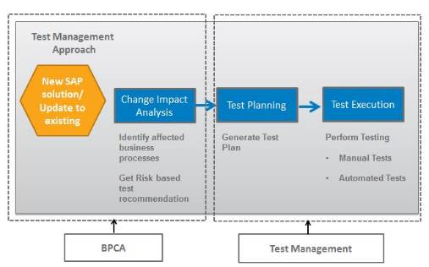
Looking Ahead
Targeted Testing
Standard test management Approach
Test scope identification is the important activity which helps to determine time and effort required to perform testing for Application changes including: -
Maintenance or Enhancement to SAP support packages
Configuration changes
Custom developments, etc.
High Level Roadmap
Targeted Testing is a key implementation Planned for TPM Regression testing with the help of Business Process Change Analyzer to capture and Validate impacted areas due to a change made to the application
Business Process Mapping Readiness status
OTC
Pricing
FI
CTC
Logistics
PTS
STS
- Completed

Slide 9
PDSC AUTOMATION
Notes:
Section breaker slide
Used for a section heading. You may add a sub heading not exceeding one line also here
Section heading – Arial Headings, bold, 34 font size, should not exceed beyond 1 line
Sub Head – Arial Headings, normal, 18 font size, should not exceed beyond 1 line

Slide 10
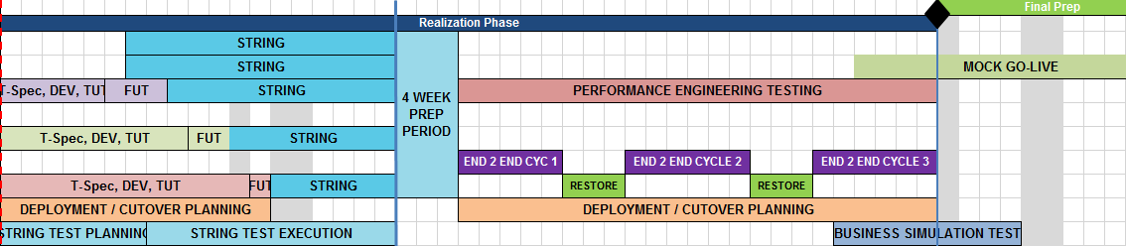
Regression Timeline for PDSC
2015
2016
2017
Total of 912 Regression Test Cases will be executed for each Regression Cycle
PDSC
Regression Execution
PDSC
Regression Execution
PDSC
Regression Execution
PDSC
Regression Execution
PDSC Regression Suite (912)
DISTRACK (617)
SCORE (125)
CORE DB (114)
RECALL (56)

Slide 11
PDSC - SCORE
Notes:
Section breaker slide
Used for a section heading. You may add a sub heading not exceeding one line also here
Section heading – Arial Headings, bold, 34 font size, should not exceed beyond 1 line
Sub Head – Arial Headings, normal, 18 font size, should not exceed beyond 1 line

Slide 12
Automation Savings in Score Upgrade Project
As a part of Score Automation, a total of 620 Test Cases are written to cover entire Score regression testing.
Out of the 620 test cases, 344 test case are automated.
125 automation test cases are executed as a part of Score upgrade project.
There is a effort saving of 6 business days and cost saving of $4586.92 for Score Upgrade project due to the 125 automation scripts.
Effort Savings=44.25 hours/125 Test Cases

Slide 13
Challenges, Solution and Achievements
Key Challenges
Key Challenges
Batch Job
  Inter dependencies between Batch Jobs
  Execution time of Batch jobs
Solution
Performed dependency analysis on the test scenarios across various modules w.r.t batch jobs and came up with the parallel execution plan.
Many batch jobs in SCORE takes several minutes for execution (up to 45mts). Automation Scripts were handled with monitoring mechanism with Delay option to wait until the job’s successful completion / Failure.
Achievements
Received excellent feedback from Paul Buster for Test Case Analysis, Test Coverage and Test Automation
Successfully completed two release within 2 days for each Cycle
Notes:
Content Slide: This is usually the most frequently used slide in every presentation.
Use this slide for Text heavy slides. Text can only be used in bullet points
Title Heading – font size 30, Arial Heading
Slide Content – Should not reduce beyond Arial body font 16
If you need to use sub bullets please use the indent buttons located next to the bullets buttons in the tool bar and this will automatically provide you with the second, third, fourth & fifth level bullet styles and font sizes
Please note you can also press the tab key to create the different levels of bulleted content

Slide 14
PDSC - DISTRACK
Notes:
Section breaker slide
Used for a section heading. You may add a sub heading not exceeding one line also here
Section heading – Arial Headings, bold, 34 font size, should not exceed beyond 1 line
Sub Head – Arial Headings, normal, 18 font size, should not exceed beyond 1 line

Slide 15
Problem Statement, Approach and Solution
Problem Statement
To have a regression suite ready for testing any functional changes in Distrack in the coming future
Readiness for addressing the Testing of the targeted areas impacted due to the PMOD changes.
Approach
Identification of High level scenarios
Review session with stakeholder
Sign-off / Approval
Knowledge Transfer
Manual Test Case Development
Automation Planning & Script Development
Automation Script Sign - off
Steps aligned for testing the PMOD Changes
  Better understanding of PMOD wricef’s to analyze and identify the targeted areas for Testing
  Prioritization of Area’s (Modules, sub- Modules) impacted by PMOD, by discussing with stake holders
  Aligning the prioritization of these modules w.r.t PMOD Changes.

Slide 16
Challenges and Solution
Key Challenges
Key Challenges
Identification of the area’s affected by PMOD
  SME identification for the PMOD affected areas, so that we can understand the application level changes and build effective test scenarios accordingly.
Unavailability of Environment
Co-ordination with different applications teams during the Test execution.
Data Setup
Test execution from HP ALM for the CSW Module
Solution
Performed dependency analysis on the test scenarios across various modules w.r.t batch jobs and came up with the parallel execution plan
Optimizing and creating new queries for Test Data Set up and also reducing the dependencies across different teams.
Notes:
Content Slide: This is usually the most frequently used slide in every presentation.
Use this slide for Text heavy slides. Text can only be used in bullet points
Title Heading – font size 30, Arial Heading
Slide Content – Should not reduce beyond Arial body font 16
If you need to use sub bullets please use the indent buttons located next to the bullets buttons in the tool bar and this will automatically provide you with the second, third, fourth & fifth level bullet styles and font sizes
Please note you can also press the tab key to create the different levels of bulleted content

Slide 17
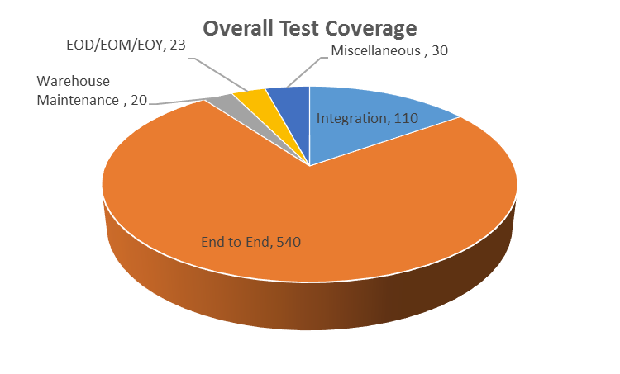
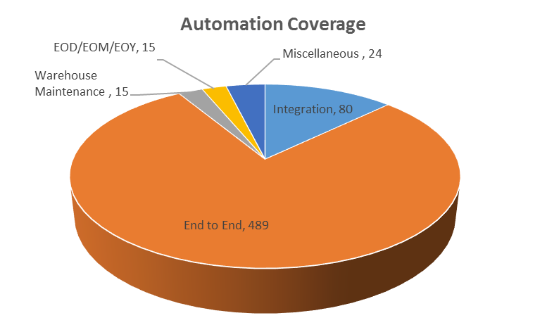
Automation Coverage - Distrack
Modules | Manual | Automation
Order Channels | 110 | 80
Order Entry | 123 | 90
Allocation | 115 | 97
Picking | 75 | 75
Invoicing | 90 | 90
Manifest | 30 | 30
Receiving | 67 | 67
Returns/Credits | 20 | 20
Debit/Morgue | 20 | 20
Warehouse Maintenance | 20 | 15
EOD/EOM/EOY | 23 | 15
Miscellaneous | 30 | 24
Total | 723 | 623

Slide 18
PDSC – RECALL & Core DB
Notes:
Section breaker slide
Used for a section heading. You may add a sub heading not exceeding one line also here
Section heading – Arial Headings, bold, 34 font size, should not exceed beyond 1 line
Sub Head – Arial Headings, normal, 18 font size, should not exceed beyond 1 line

Slide 19
PDSC – RECALL & Core DB
RECALL
Recall started with an initial plan of 30 Test Scenarios. Which have been developed
Test Automation is currently on hold as the tool for Automation is yet to be decided
After the review from the stake holders, Test Scenarios count has been revised to 60 Scenarios
Core DB
We started with CoreDB early to utilize the resources due to the delay in tool selection for Distrack an Recall
Completed 65 Manual Test Cases and 25 Automation Test Scripts
Key Challenges
Object Identification Issues – CCDB and MIF Applications
Identification of Integration scenarios
Getting the access to the downstream applications
Notes:
Column content slide
This is a slide with 2 columns and you can have text in bullet points under each column. You can have separate header for each of the columns in the blue box provided on top of each of the columns.
Heading font size of the column should remain at 30 and the column content font size should not reduce beyond 16.

Slide 20
AGILE Testing
Notes:
Section breaker slide
Used for a section heading. You may add a sub heading not exceeding one line also here
Section heading – Arial Headings, bold, 34 font size, should not exceed beyond 1 line
Sub Head – Arial Headings, normal, 18 font size, should not exceed beyond 1 line

Slide 21
Agenda
2
The FUSE Story
2
Project Overview – Team Structure Roles and Responsibilities and Tools Used
3
Key Challenges and Solutions
Notes:
Agenda slide
Heading – Agenda - Font size 30, Arial Headings
Agenda points to be in Arial Body (font size 28)
Please restrict this slide with just 5 agenda points.
If you have more than 5 points on the agenda slide please add another slide.
If you have only 3 then you can use just one slide and delete the other 2 points.

Slide 22
The FUSE Story
Notes:
Section breaker slide:
Used for a section heading. You may add a sub heading not exceeding one line also here
Section heading – Arial, bold, 34 font size, should not exceed beyond 1 line
Sub Head – Arial, normal, 20 font size, should not exceed beyond 1 line

Slide 23
At the Table in Fuse`
All members sitting at the table need to empower themselves to switch technical roles and responsibilities
Developers build/develop what “should work”
Focus and Automate Unit Testing
Involve BA and Users to test. Product Owner Signs off User Stories
The concept of “Minimum Viable Product”
No Standard QC process across the organization
Integration of Project Tracking and Test Management
Top QC recommendations:
  Estimate and provide consensus to Story Points
  Document Acceptance Criteria
  Create Go-No-Go Documentation

Slide 24
Project Overview – Team Structure, Roles and Responsibilities and Tools Used
Notes:
Section breaker slide:
Used for a section heading. You may add a sub heading not exceeding one line also here
Section heading – Arial, bold, 34 font size, should not exceed beyond 1 line
Sub Head – Arial, normal, 20 font size, should not exceed beyond 1 line

Slide 25

Team Structure, Roles and Responsibilities and Tools Used
Pharma - Specialties
Practice & Advance Practice Analytics
Pharma - Retail
Managed Care - Continuous Improvement
Medical
Optifreight
QA
BA, QA
QA
JIRA
Qlikview
Teradata, SQL Server
JIRA
Axure
SQL Server
JIRA
Oracle
SQL Server
Pharma - Specialties
Regimen Analyzer
Pharma - Retail
PD Retail Electronic Enrollment
BA, QA
QA
JIRA
JIRA
Requirement Analysis
Create User Stories
Sprint Planning
Prioritize User Stories
Review Backlog
3 Amigos
Assign Story Points
Assign Acceptance Criteria
Stand Up
Status
Testing
Functional, UI
Data Validation
Retrospective
Keep Doing
Start Doing
Work
Plan
Blockers and Achievements
Stop
Doing

Slide 26
Key Challenges & Solutions
Notes:
Section breaker slide:
Used for a section heading. You may add a sub heading not exceeding one line also here
Section heading – Arial, bold, 34 font size, should not exceed beyond 1 line
Sub Head – Arial, normal, 20 font size, should not exceed beyond 1 line

Slide 27
Key Challenges & Solutions
Project
Challenge
Solution
No Dedicated Test Database available to test against stable build for APA reports
Co-ordinated with Developers, Qlikview admin and ensured an agreement to publish a separate testing specific qvw. Once validated successfully this is merged with the main qvw in Stage.
Managed Care - Continuous Improvement
In projects where the same person performs the role of a BA and QA, simultaneous activity and tracking is required on two successive sprints
Practice & Advance Practice Analytics
Complex data calculations from different reports and sources
Collect and place an agreed volume and set of data in a Summary table for key contracts/customer accounts.
Implemented the concept of Business Rule book, that contains the User Stories, Business Rules, Test Acceptance Criteria and Test Status in a concise format and in a single location.

Slide 28
EDI Testing
Notes:
Section breaker slide:
Used for a section heading. You may add a sub heading not exceeding one line also here
Section heading – Arial, bold, 34 font size, should not exceed beyond 1 line
Sub Head – Arial, normal, 20 font size, should not exceed beyond 1 line

Slide 29
EDI Engagement – The Past and The Present
Background:
QC team has been supporting EDI testing since 2007.
Testing was limited to small enhancements and defects fixes in VAPS.
Currently we support:
Both Build and Run work.
Functional, Integration and End to End Testing in VAPS and Supplier EDI.
Improved Regression coverage in VAPS.
Defining Regression suite in Supplier EDI.
Streamlining test/ data support to other teams (OE, DTK).
Alignment with EDI Run team for improved demand forecasting.
TCoE team has accomplished the following:
-
AI Build, Track & Trace implementation, DoD Pharma initiatives.
Major Projects:
Notes:
Content Slide: This is usually the most frequently used slide in every presentation.
Use this slide for Text heavy slides. Text can only be used in bullet points
Title Heading – font size 30, Arial Heading
Slide Content – Should not reduce beyond Arial body font 16
If you need to use sub bullets please use the indent buttons located next to the bullets buttons in the tool bar and this will automatically provide you with the second, third, fourth & fifth level bullet styles and font sizes
Please note you can also press the tab key to create the different levels of bulleted content

Slide 30
Upcoming Engagements
Key Challenges
CVS Channel Shift -
CVS being the strategic partner is requiring changes to Rx ordering solutions to flow through EDI in order to achieve less store level ordering. CVS has ~6000 stores which has to be migrated to support EDI
With this change CVS will become the biggest EDI Customer for Cardinal.
Testing Engagement is till May 16.
PMOD EDI -
26 Wricef objects corresponding to 100 new maps to be developed and tested.
Testing to Perform: String Testing, Comparison Testing, Functional Testing, Regression Testing (Test scenario and Maps to identified)
Testing Engagement will be till Nov 2016
Track and Trace Phase ll
Initiate project phase ,High level requirement has been shared
Testing Engagement will be till Feb 2016
Notes:
Content Slide: This is usually the most frequently used slide in every presentation.
Use this slide for Text heavy slides. Text can only be used in bullet points
Title Heading – font size 30, Arial Heading
Slide Content – Should not reduce beyond Arial body font 16
If you need to use sub bullets please use the indent buttons located next to the bullets buttons in the tool bar and this will automatically provide you with the second, third, fourth & fifth level bullet styles and font sizes
Please note you can also press the tab key to create the different levels of bulleted content

Slide 31
Thank You

